Slide 1
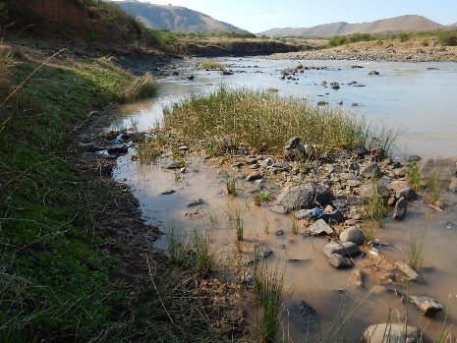
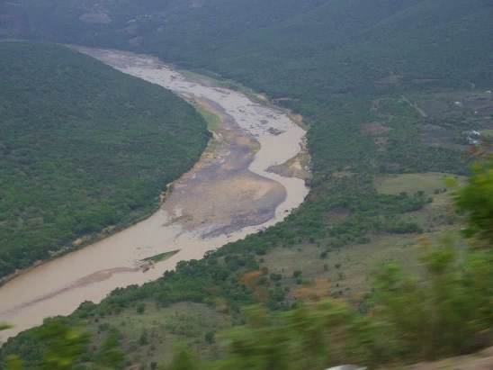
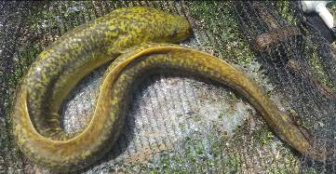
WP 11004: PSC MEETING 4, 15 MAY 2018
PRESENTATION TITLE
Presented by:
Name Surname
Directorate
Date
DETERMINATION OF WATER RESOURCE CLASSES AND RESOURCE QUALITY OBJECTIVES FOR THE WATER RESOURCES IN THE MZIMVUBU CATCHMENT:
ESTUARY RESOURCE QUALITY OBJECTIVES
Susan Taljaard

Slide 2
MZIMVUBU ESTUARY DELINEATION
Estuary functional zone (EFZ) defines geographical boundaries for estuaries, in the case of the Mzimvubu Estuary:
Downstream boundary: Estuary mouth (31º37'52” S, 29º32'59” E)
Upstream boundary: limits of tidal variation or salinity penetration, whichever penetrates furthest (31º29'7.15"S, 29º22'59.66"E)
Lateral boundary: ±5 m contour above Mean Sea Level along each bank as per Survey and Mapping (Mowbray)

Slide 3
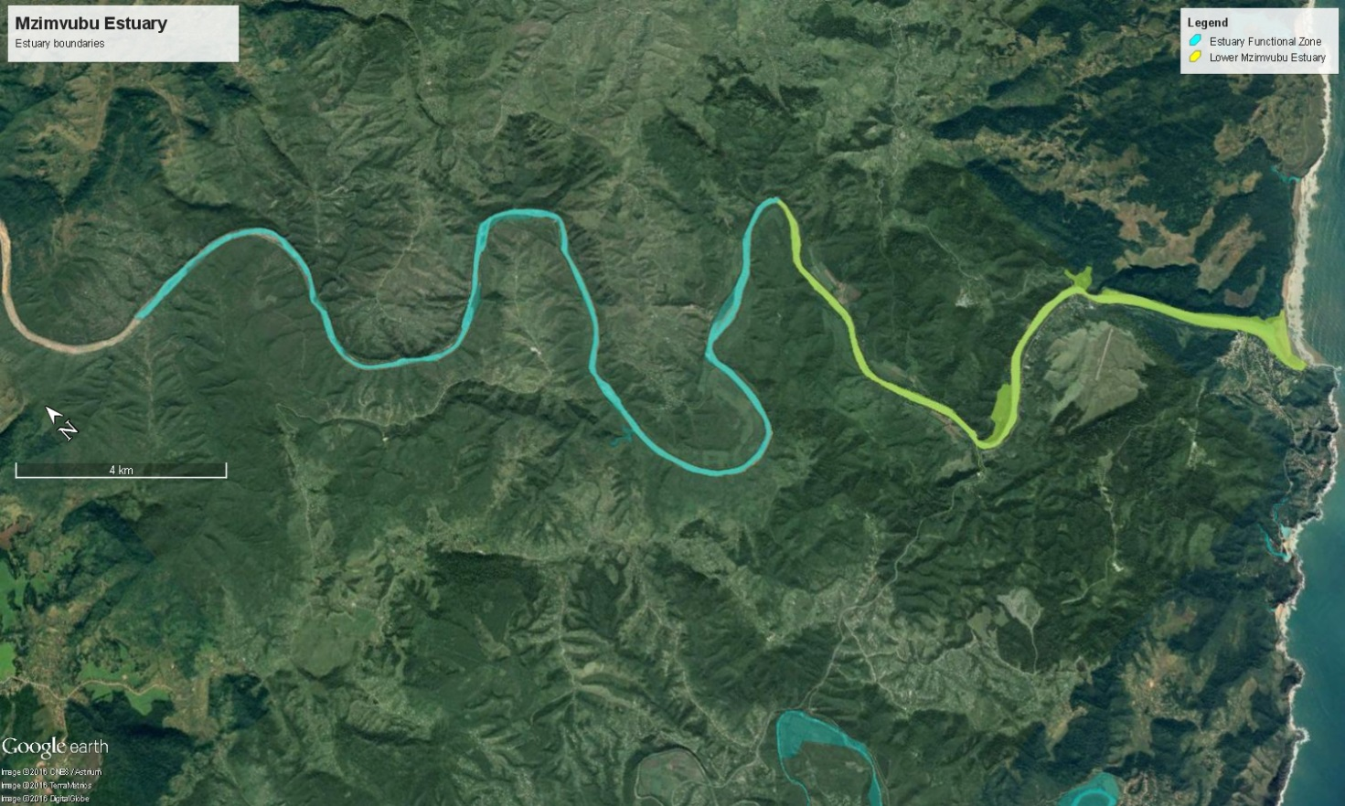
MZIMVUBU ESTUARY RU
Estuary freshwater dominated with minimal saline intrusion (although tidal variation extends to upper boundary
Notes:
3

Slide 4
ESTUARY IMPORTANCE
Ecological Importance: Highly Important
WMA largely unregulated, one of few in region (i.e. no cross-basin transfers)
Catchment supply high levels of ecological services nationally (SANBI undertaking economic importance assessment)
Estuary used by Zambezi sharks as a pupping / nursery ground
Nursery for White steenbras and Dusky kob - very limited suitable nursery habitat left in South Africa
System plays significant role in delivery of sediments and nutrients/detritus to marine environment, nourishing local beaches and marine ecosystems
Designated as priority estuary - needs protection to meet South Africa’s biodiversity targets under National Estuarine Biodiversity Plan (NBA, 2011)

Slide 5
ESTUARY PES
Ecological Category B
Most of changes not as result of flow modification, but rather (non-flow related pressure) such as (some more difficult to remove):
Habitat destruction
Alien invasive plants
Nutrient enrichment (pollution)
Over-fishing
Human disturbances to birds
Larger scale removal of fish stock

Slide 6
TARGET ECOLOGICAL CATEGORY
TEC: Category B ~ PES and REC, but to maintain also require:
Return some variability to mouth dynamics, e.g. remove access road currently entraining mouth (“First Beach”)
Re-instate some sediment dynamics (as above) possibility resulting in re-establishment of beach at “First Beach”
Institute land-use management regulation in EFZ zone to restrict loss of further habitat within EFZ, as well as floodplain (to +10 m MSL)
Rehabilitate disturbed areas in EFZ (where possible) to enhance functional integrity and importance of system
Establish Invasive Alien Plant Management Programme to enhance functional importance of floodplain areas
Manage fishing pressure to protect important fish stocks and sensitive habitats (e.g. by considering partial closure)
Address pollution risks, e.g. canalised creek flowing from Port St Johns

Slide 7
RESOURCE QUALITY OBJECTIVES
(for TEC Category B)
Hydrology | A/B | River inflow distribution not to vary more than 5% from Scenario 96
Hydrodynamics | B | Estuary mouth not to close or become very constricted Changes in tidal amplitude (tidal gauge) < 20% from present baseline (2017)
Physical habitat (sediments) | A | Difference in river inflow distribution patterns (flood components) < 20% from that simulated for the present state (2017) (magnitude, timing and variability) Difference in suspended sediment concentration (river inflow) < 20% of sediment load-discharge relationship of present baseline (2017) Limited deviation in sedimentation and erosion patterns (± 0.5 m) from present baseline (2017) Deviation in median bed sediment diameter < factor of 2 from present baseline (2017) Deviation in sand/mud distribution (middle and upper reaches) <20% from present baseline (2017)

Slide 8
RESOURCE QUALITY OBJECTIVES
(for TEC Category B)
Water quality (salinity) | A/B | Salinity (lower reaches) > 20 at least 4-6 months Salinity (lower reaches) > 25 and (middle reaches) > 15 at least 1-2 months
Water quality (other) | C | pH 7.0 - 8.5 DO > 6 mg/ℓ Turbidity (naturally turbid system) Total metal concentrations in water not to exceed target values as per SA Water Quality Guidelines Total metal concentration in sediment not to exceed target values as per Western Indian Ocean Regional guidelines River: Dissolved Inorganic Nitrogen (DIN) < 200 μg/ℓ (monthly average) Dissolved Inorganic Phosphate (DIP) < 30 μg/ℓ (monthly average) Estuary: Dissolved Inorganic Nitrogen (DIN) < 150 μg/ℓ (average estuary) Dissolved Inorganic Phosphate (DIP) < 20 μg/ℓ (average estuary)

Slide 9
RESOURCE QUALITY OBJECTIVES
(for TEC Category B)
Microalgae | C | Maintain low phytoplankton biomass (average chlorophyll a < 20 µg/ℓ or median chlorophyll a < 3.5 µg/ℓ) and a diversity of phytoplankton groups (cyanobacteria excluded). Maintain medium intertidal benthic microalgal biomass (median chlorophyll a < 23 mg/m²) No observable blooms and scums in the estuary Absence of cyanobacteria
Macrophytes | C/D | Maintaining diversity of macrophyte habitats as per present baseline (2017) Reeds and sedges covering maintained at ~16 ha. No more than 50% loss of reed and sedge habitats in non-flood year (e.g. linked to unfavourable salinity regime) No increase in invasive species in riparian zone No colonisation main channel by vegetation (linked to sedimentation)

Slide 10
RESOURCE QUALITY OBJECTIVES
(for TEC Category B)
Invertebrates | A/B | Maintain low-diversity invertebrate community with representation of present baseline (2017) freshwater, opportunistic taxa Maintain invertebrate community structured as per present baseline (2017) (defined by inherent physico-chemical drivers, e.g. salinity) Maintain invertebrate community structured as per present baseline (2017) (linked to channel-like nature of estuary results with very few intertidal areas and soft sediments supporting only suitably specialised species)

Slide 11
RESOURCE QUALITY OBJECTIVES
(for TEC Category B)
Fish | B/C | Abundance of estuarine dependence category IIa species present as young juveniles in winter/spring/early summer (Solea bleekeri, Acanthopagrus vagus, Pomadasys commersonnii, Agyrosomus japonicus, Rhabdosargus holubi) - any one of these species not to be absent in system in two consecutive years Good trophic basis for predatory estuarine dependant marine species (most notably Agyrosomus japonicus and Pomadasys commersonnii), but not to occur abundantly in upper reaches Estuarine resident species core group present (Glossogobius spp., Oligolepis spp. Ambassis spp. and Gilchistella aestuaria) Oreochromis mossambicus not to extent into lower reaches for more than two consecutive years No alien species No decline in catches (Agyrosomus japonicus or Pomadasys commersonnii)

Slide 12
RESOURCE QUALITY OBJECTIVES
(for TEC Category B)
Birds | C/D | Maintain avifaunal community that includes representatives of all groups as per present baseline (2017) Tern roosts observed from time to time Number of water bird species recorded per count remains above 10 for 3 consecutive seasons Summer numbers of water birds (other than gulls and terns) remain above 50 for 3 consecutive seasons (A winter threshold should be determined once more data becomes available)

Slide 13
QUESTIONS FOR CLARIFICATION

